Slide 1
FTP Upload
Software Studio 軟體設計與實驗
Hung-Kuo Chu
Department of Computer Science
National Tsing Hua University
CS2410

Slide 2
Outline
Windows
Mac

Slide 3
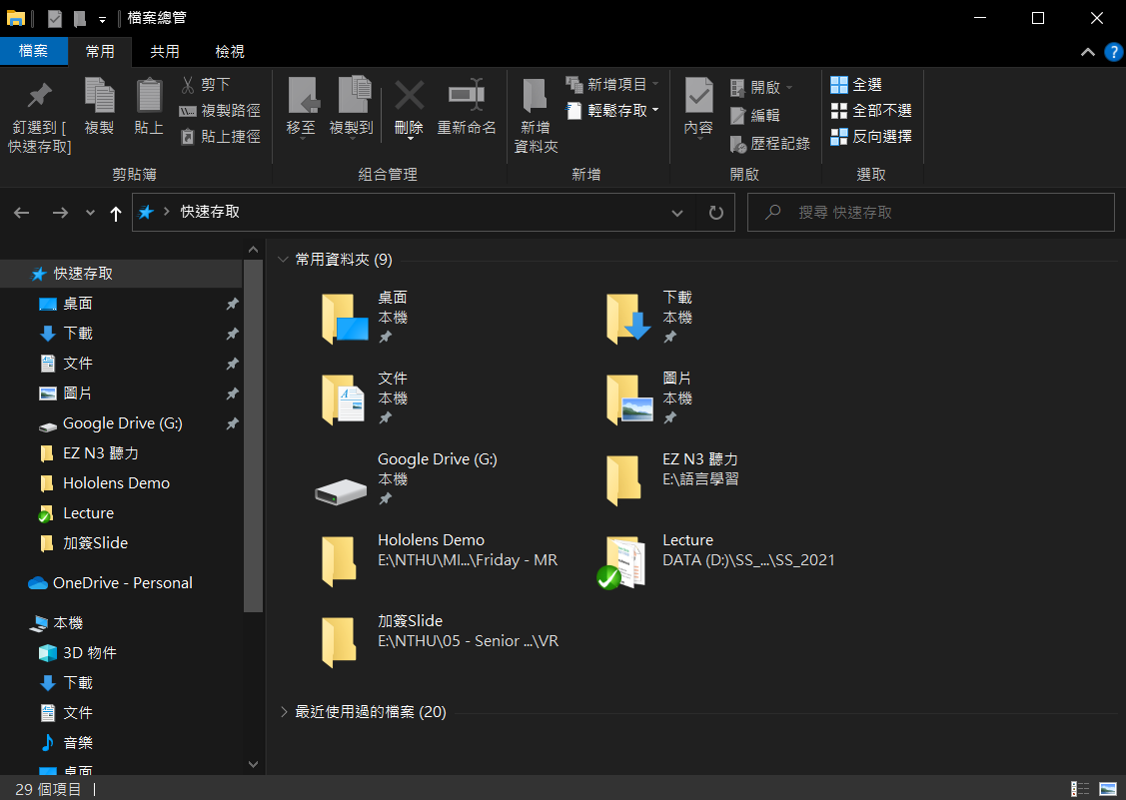
Window
◆
Open Window Explorer (檔案總管)

Slide 4
Window
❖
Type in ftp://cgv.cs.nthu.edu.tw -> Enter

Slide 5
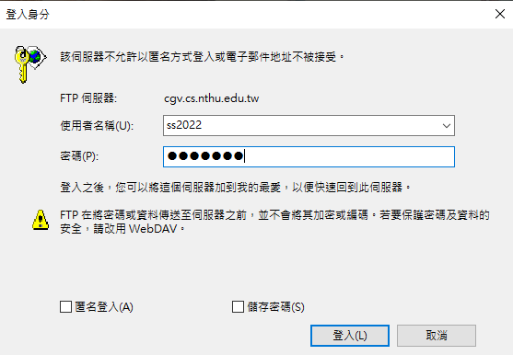
Window
⬥
Username : ss2022
Password : sf1q88d


Slide 6
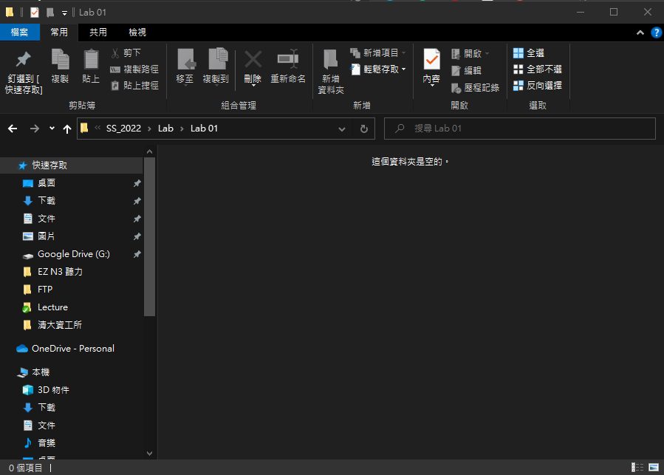

Window

Drag the file into the target folder directly

Slide 7
Outline
Windows
Mac

Slide 8
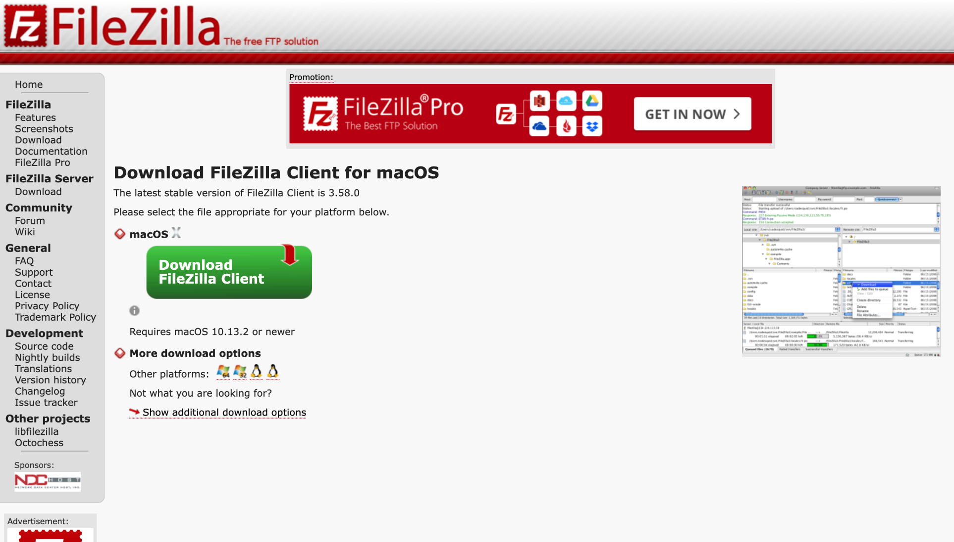
Mac
◆
Download FileZilla

Slide 9
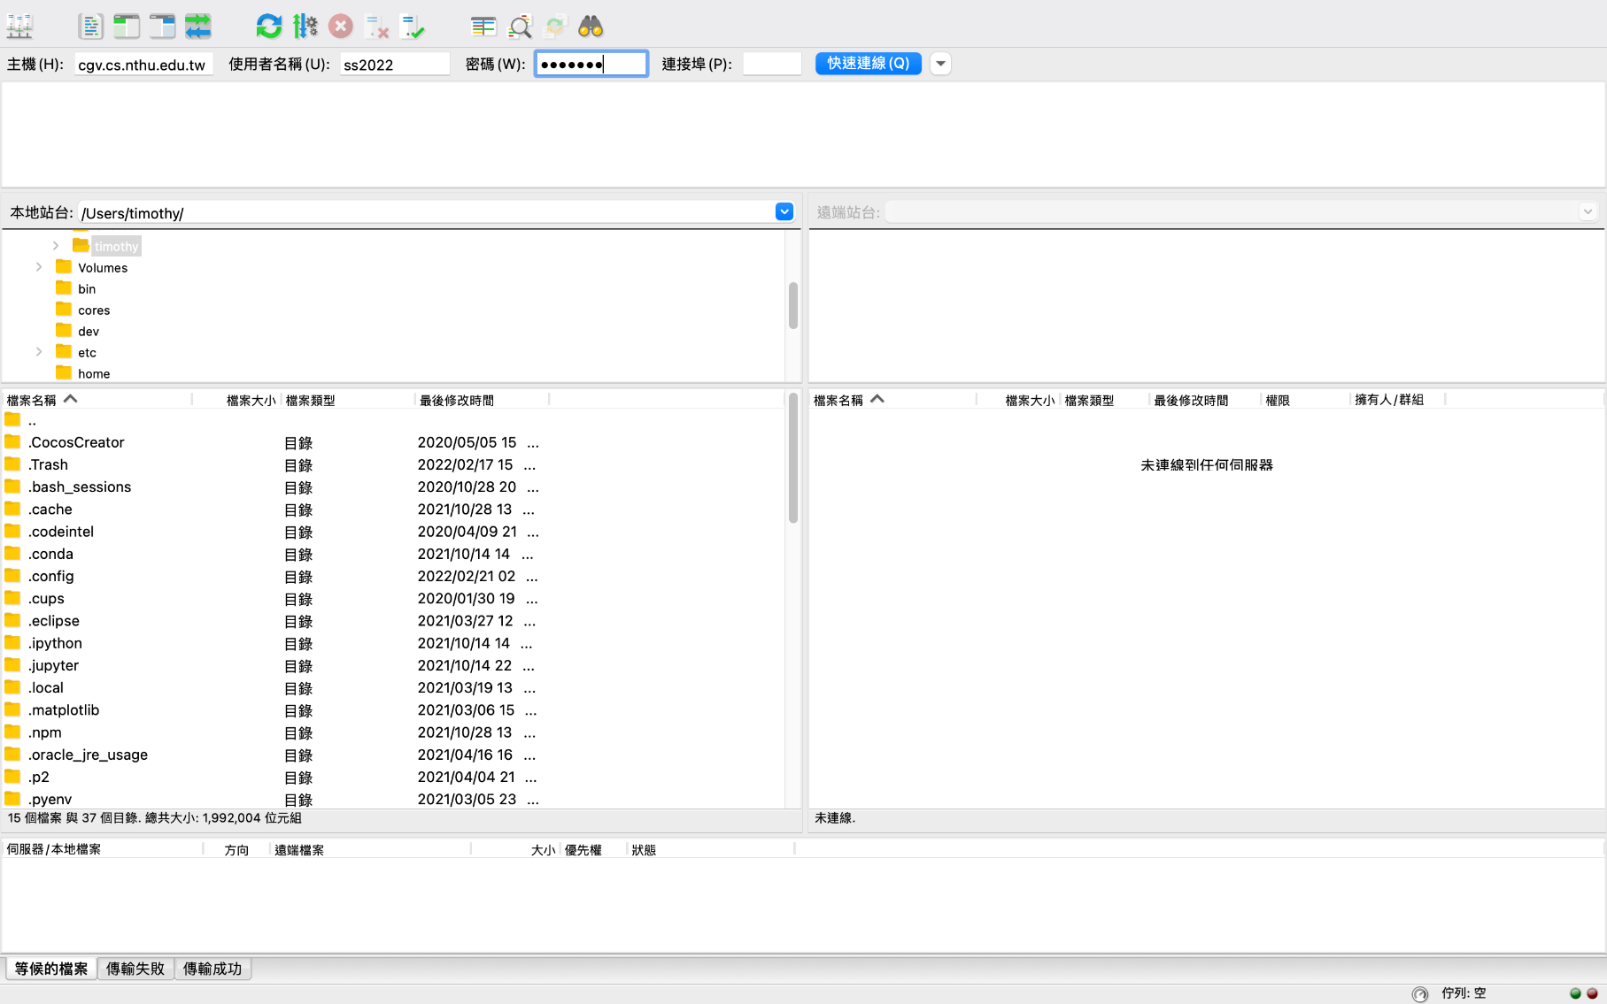
Mac
❖
Open FileZilla
⬥

Host : cgv.cs.nthu.edu.tw
Username : ss2022
Password : sf1q88d

Slide 10
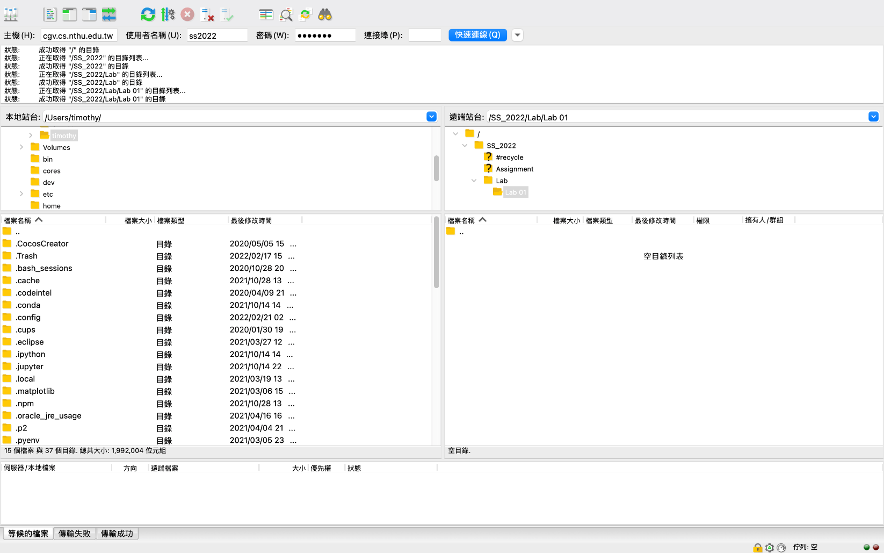
Mac

Drag the file into the target folder directly

